Slide 1
IMDB-Movies
Dataset Analysis
Presented by Farukh Ahmad

Slide 2
Introduction
This project explores a comprehensive movie dataset to uncover key insights about the film industry. The analysis focuses on understanding trends in movie production, revenue generation, and genre popularity. By evaluating this data, we aim to provide a clearer picture of how movies have evolved over time and what factors contribute to their success.

Slide 3
Dataset Summary
Total Movies: [Number of Movies in Dataset]
Total Genres: [Number of Unique Genres]
Total Directors: [Number of Unique Directors]
Total Actors: [Number of Unique Actors]

Slide 4
Data Source
The dataset was sourced from a structured CSV file containing information on 1000 movies made from 2006 to 2016 including genres, revenue, ratings, and key participants like actors and directors.

Slide 5
Objectives
Main Goals:
To understand movie production trends over time.
To analyze revenue and rating patterns across different genres, directors, and actors.
To identify high-grossing movies and popular genres.
Analytical Questions:
Which genres have gained or lost popularity?
Which directors and actors are associated with the highest-grossing movies?
How has movie production volume changed over the year?

Slide 6
Step Followed
1- Data Cleaning
2- Data Transformation
3- Visualization and Analysis

Slide 7
1- Data Cleaning
I followed these steps to make sure that the data is cleaned and ready to transform
Identify nulls
Identify duplicates
Converting nulls to ‘0’
Rounding off rating and revenue values
Results: One Movie "The Host" found which exist two times but they have different actors and directors so I renamed one movie as "The Host 2".

Slide 8
2- Data Transformation
I followed steps in these sequence to transform the data
Create dimension tables
Inserting data into dimension table
Creating Fact Table
Inserting data into Fact Table
Creating Junction Tables(for many-to-many relationships)
Inserting data into Junction Tables
Creating Views
The reason for creating junction tables is that each movie had multiple genres and actors listed in a single row, separated by commas.

Slide 9
Transformed Data
Dimension Tables:
GenreDIM(GenreID,Genre)
DirectorDim(Director,DirectorID)
ActorDim(Actor,ActorID)
YearDim(Year,YearID)
Junction Tables:
MoviesActors(MovieID,ActorID)
MoviesGenres(MovieID,GenreID)
FactTable:
MovieFact (MovieID,Title,DirectorID,YearID,RunTime, Rating, Votes, Revenue_in_Millions,MetaScore,FOREIGN KEY (DirectorID) REFERENCES DirectorDIM(DirectorID),FOREIGN KEY (YearID) REFERENCES YearDIM(YearID))

Slide 10
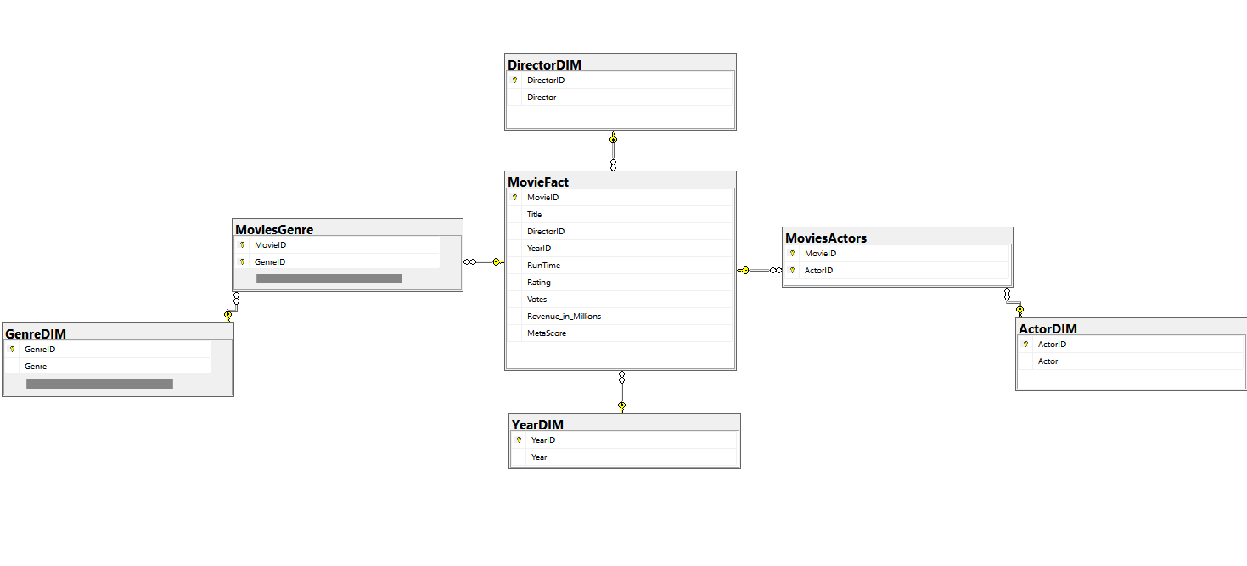
Data Modeling Diagram

Slide 11

3- Visualization and analysis
After completing the data cleaning and modeling , I loaded all the data into PowerBI for visualization using basic charts e.g bar and line charts.

Slide 12
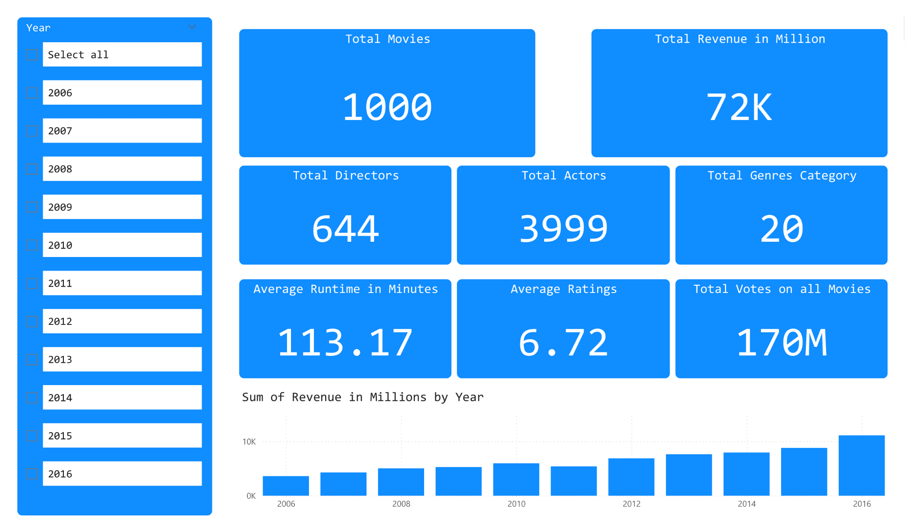
Basic Analysis
Basic Analysis

Slide 13
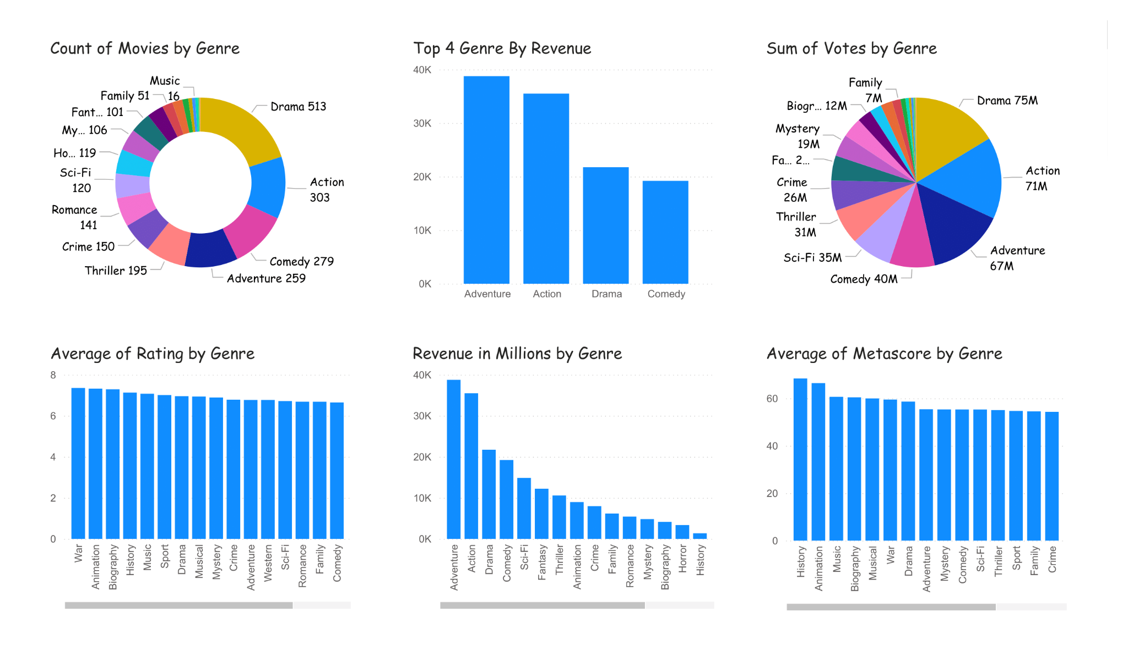
Genre-Based Analysis
Basic Analysis

Slide 14
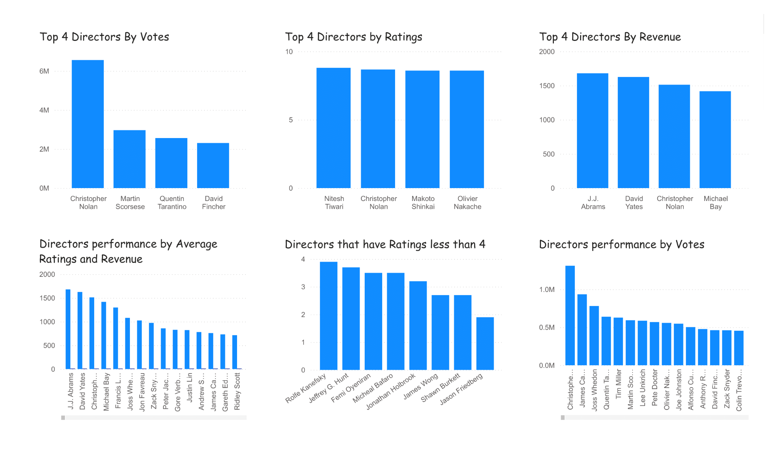
Director-Based Analysis
Basic Analysis

Slide 15
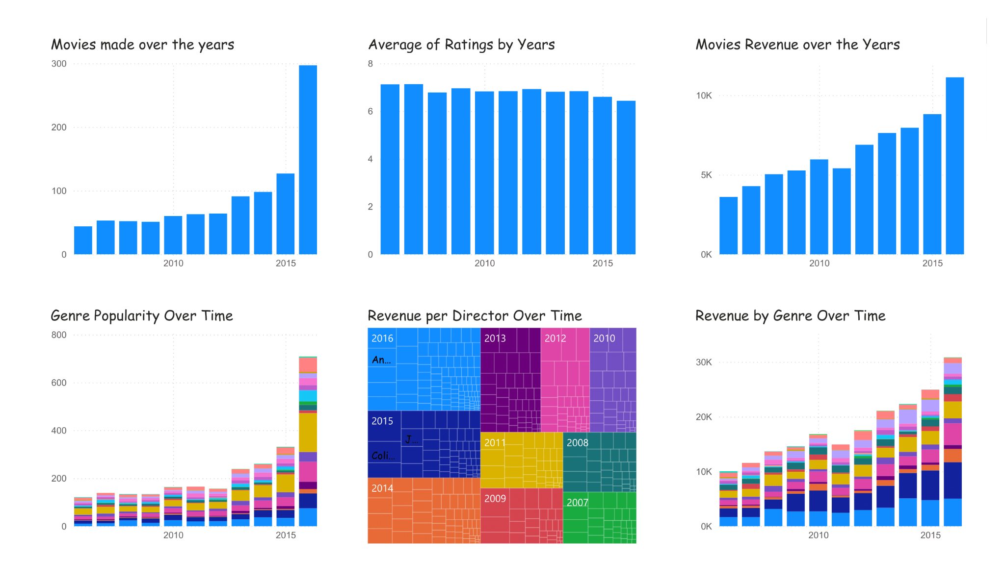
Time-Based Analysis
Basic Analysis

Slide 16
Key Insights
Number of movies increases by years.
High revenue genres are Adventure, Action, Drama and Comedy.
The average rating is 6 means that ratio between like and dislike is 60/40.
The revenue of the director does not depend on the ratings and votes
The revenue of the movies does not depend on the ratings, votes or metascore.

Slide 17
Q/A

